Slide 1
6.830 Lecture 7
B+Trees & Column Stores
9/27/2017
Project meeting signup: https://goo.gl/TfSCjb

Slide 2
Study Break (Last Time)
Assuming disk can do 100 MB/sec I/O, and 10ms / seek
And the following schema:
grades (cid int, g_sid int, grade char(2))
students (s_int, name char(100))
Estimate time to sequentially scan grades, assuming it contains 1M records (Consider: field sizes, headers)
Estimate time to join these two tables, using nested loops, assuming students fits in memory but grades does not, and students contains 10K records.

Slide 3
Seq Scan Grades
grades (cid int, g_sid int, grade char(2))
8 bytes (cid) + 8 bytes (g_sid) + 2 bytes (grade) + 4 bytes (header) = 22 bytes
22 x 1M = 22 MB / 100 MB/sec = .22 sec + 10ms seek
➔ .23 sec

Slide 4
NL Join Grades and Students
grades (cid int, g_sid int, grade char(2))
students (s_int, name char(100))
10 K students x (100 + 8 + 4 bytes) = 1.1 MB
Students Inner (Preferred)
Cache students in buffer pool in memory: 1.1/100 s = .011 s
One pass over students (cached) for each grade (no additional cost beside caching)
Time to scan students (previous slide) = .23 s
.241 s
Grades Inner
One pass over grades for each student, at .22 sec / pass, plus one seek at 10 ms (.01 sec) ➔ .23 sec / pass
~2300 seconds overall
(Time to scan students is .011 s, so negligible)

Slide 5
Indexes
 | Heap File | B+Tree | Hash File
Insert | O(1)
Delete | O(P)
Scan | O(P)
Lookup | O(P)
n : number of tuples
P : number of pages in file
B : branching factor of B-Tree
R : number of pages in range

Slide 6
Hash Index
n buckets, on n disk pages
Disk page 1
…
Disk Page n
On Disk Hash Table
(‘sam’, 10k, …)
(‘joe’, 20k, …)
H(f1)
e.g., H(x) = x mod n
Issues
How big to make table?
If we get it wrong, either
waste space, or
end up with long overflow chains, or
have to rehash

Slide 7
Extensible Hashing
Create a family of hash tables parameterized by k
H_{k}(x) = H(x) mod 2^{k}
Start with k = 1 (2 hash buckets)
Use a directory structure to keep track of which bucket (page) each hash value maps to
When a bucket overflows, increment k (if needed), create a new bucket, rehash keys in overflowing bucket, and update directory

Slide 8
Example
Directory
k=1
Hash Table
H_{k}(x) | Page
0 | 0
1 | 1
Page Number | Page Contents
0
1
H_{k}(x) = x mod k
Insert records with keys 0, 0, 2, 3, 2

Slide 9
Example
Directory
k=1
Hash Table
H_{k}(x) | Page
0 | 0
1 | 1
Page Number | Page Contents
0
1
0
0 mod 2 = 0
H_{k}(x) = x mod 2^k
Insert records with keys 0, 0, 2, 3, 2

Slide 10
Example
Directory
k=1
Hash Table
H_{k}(x) | Page
0 | 0
1 | 1
Page Number | Page Contents
0 | 0 | 0
1
0 mod 2 = 0
H_{k}(x) = x mod k
Insert records with keys 0, 0, 2, 3, 2

Slide 11
Example
Directory
k=1
Hash Table
H_{k}(x) | Page
0 | 0
1 | 1
Page Number | Page Contents
0 | 0 | 0 | 2
1
2 mod 2 = 0
H_{k}(x) = x mod k
Insert records with keys 0, 0, 2, 3, 2

Slide 12
Example
Directory
k=1
Hash Table
H_{k}(x) | Page
0 | 0
1 | 1
Page Number | Page Contents
0 | 0 | 0 | 2
1 | 3
3 mod 2 = 1
H_{k}(x) = x mod k
Insert records with keys 0, 0, 2, 3, 2

Slide 13
Example
Directory
k=1
Hash Table
H_{k}(x) | Page
0 | 0
1 | 1
Page Number | Page Contents
0 | 0 | 0 | 2
1 | 3
- FULL!
2 mod 2 = 0
H_{k}(x) = x mod k
Insert records with keys 0, 0, 2, 3, 2

Slide 14
Example
Directory
k=1 2
Hash Table
H_{k}(x) | Page
0 | 0
1 | 1
2
3
Page Number | Page Contents
0 | 0 | 0 | 2
1 | 3
H_{k}(x) = x mod k
Insert records with keys 0, 0, 2, 3, 2

Slide 15
Example
Directory
k=1 2
Hash Table
H_{k}(x) | Page
0 | 0
1 | 1
2 | 2
3
Page Number | Page Contents
0 | 0 | 0 | 2
1 | 3
2
Allocate new page!
H_{k}(x) = x mod k
Insert records with keys 0, 0, 2, 3, 2

Slide 16
Example
Directory
k=1 2
Hash Table
H_{k}(x) | Page
0 | 0
1 | 1
2 | 2
3 | 1
Page Number | Page Contents
0 | 0 | 0 | 2
1 | 3
2
Rehash
Only allocate 1 new page!
H_{k}(x) = x mod k
Insert records with keys 0, 0, 2, 3, 2

Slide 17
Example
Directory
k=1 2
Hash Table
H_{k}(x) | Page
0 | 0
1 | 1
2 | 2
3 | 1
Page Number | Page Contents
0 | 0 | 0
1 | 3
2 | 2
2 mod 4 = 2
H_{k}(x) = x mod k
Insert records with keys 0, 0, 2, 3, 2

Slide 18
Example
Directory
k=1 2
Hash Table
H_{k}(x) | Page
0 | 0
1 | 1
2 | 2
3 | 1
Page Number | Page Contents
0 | 0 | 0
1 | 3
2 | 2 | 2
2 mod 4 = 2
Extra bookkeeping needed to keep track of fact that pages 0/2 have split and page 1 hasn’t
H_{k}(x) = x mod k
Insert records with keys 0, 0, 2, 3, 2

Slide 19
Indexes
 | Heap File | B+Tree | Hash File
Insert | O(1) |  | O(1)
Delete | O(P) |  | O(1)
Scan | O(P) |  | -- / O(P)
Lookup | O(P) |  | O(1)
n : number of tuples
P : number of pages in file
B : branching factor of B-Tree
R : number of pages in range

Slide 20
B+Trees
Root node
ptr | val11 | ptr | val12 | ptr | val13 | …
<val11
ptr | val21 | ptr | val22 | ptr | val23 | …
Inner nodes
>val21, <val22
ptr | valn1 | ptr | valn2 | ptr | valn3 | …
<valn1
RIDn | RIDn+1 | RIDn+2 | ptr
RIDn+3 | RIDn+4 | RIDn+5 | ptr
Leaf nodes; RIDs in sorted order, w/ link pointers

Slide 21
B+Trees
Root node
ptr | val11 | ptr | val12 | ptr | val13 | …
<val11
ptr | val21 | ptr | val22 | ptr | val23 | …
Inner nodes
>val21, <val22
ptr | valn1 | ptr | valn2 | ptr | valn3 | …
<valn1
RIDn | RIDn+1 | RIDn+2 | ptr
RIDn+3 | RIDn+4 | RIDn+5 | ptr
Leaf nodes; RIDs in sorted order, w/ link pointers

Slide 22
B+Trees
<valn1
RIDn | RIDn+1 | RIDn+2 | ptr
RIDn+3 | RIDn+4 | RIDn+5 | ptr
Leaf nodes; RIDs in sorted order, w/ link pointers

Slide 23
Properties of B+Trees
Branching factor = B
Log_{B}(tuples) levels
Logarithmic insert/delete/lookup performance
Support for range scans
Link pointers
No data in internal pages
Balanced (see text “rotation”) algorithms to rebalance on insert/delete
Fill factor: All nodes except root kept at least 50% full (merge when falls below)
Clustered / unclustered

Slide 24
Indexes Recap
 | Heap File | B+Tree | Hash File
Insert | O(1) | O( log_{B} n ) | O(1)
Delete | O(P) | O( log_{B} n ) | O(1)
Scan | O(P) | O( log_{B} n + R ) | -- / O(P)
Lookup | O(P) | O( log_{B} n ) | O(1)
n : number of tuples
P : number of pages in file
B : branching factor of B-Tree
R : number of pages in range

Slide 25
B+Trees are Inappropriate For Multi-dimensional Data
Consider points of the form (x,y) that I want to index
Suppose I store tuples with key (x,y) in a B+Tree
Problem: can’t look up y’s in a particular range without also reading x’s

Slide 26
Example of the Problem
Have to scan every
X value to look for matching Ys

Slide 27
R-Trees / Spatial Indexes
y
x

Slide 28
R-Trees / Spatial Indexes
y
x

Slide 29
R-Trees / Spatial Indexes
y
x

Slide 31
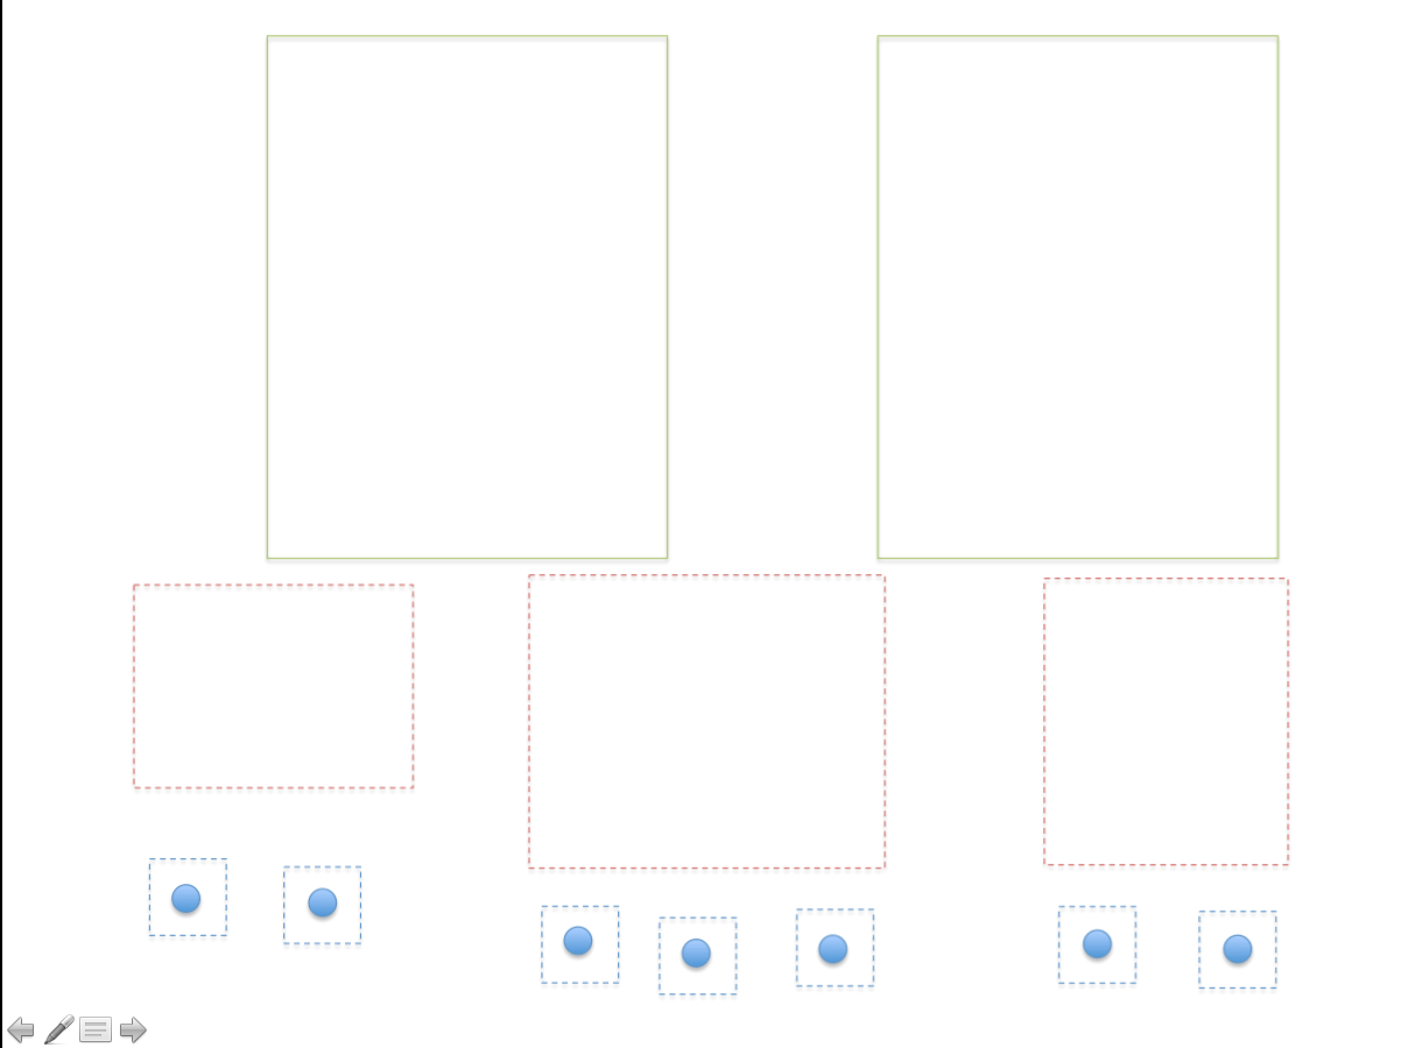
Q

Slide 32
Quad-Tree
y
x

Slide 33
Quad-Tree
y
x

Slide 34
Quad-Tree
y
x

Slide 35
Study Break
What indexes would you create for the following queries (assuming each query is the only query the database runs)
SELECT MAX(sal) FROM emp
B+Tree on emp.sal
SELECT sal FROM emp WHERE id = 1
Hash index on emp.id
SELECT name FROM emp WHERE sal > 100k
B+Tree on emp.sal (maybe)
SELECT name FROM emp WHERE sal > 100k AND dept = 2
B+tree on emp.sal (maybe), Hash on dept.dno (maybe)

Slide 36
Typical Database Setup
“Extract, Transform, Load”
Analytics / Reporting Database
“Warehouse”
Lots of reads of many records
Bulk updates
Typical query touches a few columns
Transactional database
Lots of writes/updates
Reads of individual records

Slide 37

How Long Does a Scan Take?
SELECT avg(price) FROM tickstore WHERE symbol = ‘GM’ and date = ‘1/17/2007’
Time proportional to amount of data read
Example
“Row” Representation
symbol
price
quantity
exchange
date
GM | 30.77 | 1,000 | NYSE | 1/17/2007
GM | 30.77 | 10,000 | NYSE | 1/17/2007
GM | 30.78 | 12,500 | NYSE | 1/17/2007
AAPL | 93.24 | 9,000 | NQDS | 1/17/2007
Even though we only need price, date and symbol, if data is on disk, must scan over all columns
Magnetic Disk

Slide 38

Column Representation Reduces Scan Time
Idea: Store each column in a separate file
Column Representation
GM
GM
GM
AAPL
30.77
30.77
30.78
93.24
1,000
10,000
12,500
9,000
NYSE
NYSE
NYSE
NQDS
1/17/2007
1/17/2007
1/17/2007
1/17/2007
Reads Just 3 Columns
Assuming each column is same size, reduces bytes read from disk by factor of 3/5
In reality, databases are often 100’s of columns

Slide 39
When Are Columns Right?
Warehousing (OLAP)
Read-mostly; batch update
Queries: Scan and aggregate a few columns
Vs. Transaction Processing (OLTP)
Write-intensive, mostly single record ops.
Column-stores: OLAP optimized
In practice >10x performance on comparable HW, for many real world analytic applications
True even if w/ Flash or main memory!
Different architectures for different workloads
Notes:
XXX note that won’t work well if reading a single record, or updating – explain why -- retitle

Slide 40


C-Store: Rethinking Database Design from the Ground Up
Inserts
Column-oriented query executor
Write optimized storage
Tuple
Mover
SYM
PRICE
VOL
EXCH
TIME
SYM
PRICE
VOL
EXCH
TIME
IBM |  | 100 |  | 10244 |  | NYSE |  | 1.17.07
IBM |  | 102 |  | 11245 |  | NYSE |  | 1.17.07
SUN |  | 58 |  | 3455 |  | NQDS |  | 1.17.07
Shared nothing
horizontal partitioning
IBM |  | 100 |  | 10244 |  | NYSE |  | 1.17.07
IBM |  | 102 |  | 11245 |  | NYSE |  | 1.17.07
SUN |  | 58 |  | 3455 |  | NQDS |  | 1.17.07
Separate Files
Column-based Compression
“C-Store: A Column-oriented DBMS” -- VLDB 05

Slide 41
Query Processing Example
SELECT avg(price)
FROM tickstore
WHERE symbol = ‘GM’
AND date = ‘1/17/2007’
Traditional Row Store
AVG
price
Complete tuples
SELECT
date=’1/17/07’
Complete tuples
SELECT
sym = ‘GM’
Complete tuples
Disk
GM | 30.77 | 1,000 | NYSE | 1/17/2007
GM | 30.77 | 10,000 | NYSE | 1/17/2007
GM | 30.78 | 12,500 | NYSE | 1/17/2007
AAPL | 93.24 | 9,000 | NQDS | 1/17/2007
Notes:
Disco picture/hippie joke

Slide 42

Query Processing Example
Basic Column Store
“Early Materialization”
SELECT avg(price)
FROM tickstore
WHERE symbol = ‘GM’
AND date = ‘1/17/2007’
Complete tuples
AVG
price
Complete tuples
Row-oriented plan
SELECT
date=’1/17/07’
Complete tuples
Construct Tuples
SELECT
sym = ‘GM’
GM | 30.77 | 1/17/07
Disk
GM
GM
GM
AAPL
30.77
30.77
30.78
93.24
1,000
10,000
12,500
9,000
1/17/2007
1/17/2007
1/17/2007
1/17/2007
Fields from same tuple at same index (position) in each column file
NYSE
NYSE
NYSE
NQDS

Slide 43
Query Processing Example
AVG
Much less data flowing through memory
C-Store
“Late Materialization”
Prices
Position Lookup
Position Bitmap
(1,1,1,0)
AND
Position Bitmap
(1,1,1,0)
Position Bitmap
(1,1,1,1)
Pos.SELECT
sym = ‘GM’
Pos.SELECT
date=’1/17/07’
Disk
GM
GM
GM
AAPL
30.77
30.77
30.78
93.24
1,000
10,000
12,500
9,000
NYSE
NYSE
NYSE
NQDS
1/17/2007
1/17/2007
1/17/2007
1/17/2007
See Abadi et al
ICDE 07
Notes:
Reread IQ papers on bitmap indexes and index ANDing

Slide 44
Why Compress?
Database size is 2x-5x larger than the volume of data loaded into it
Database performance is proportional to the amount of data flowing through the system
Abadi et al, SIGMOD 06

Slide 45
Column-Oriented Compression
Query engine processes compressed data
Transfers load from disk to CPU
Multiple compression types
Run-Length Encoding (RLE), LZ, Delta Value, Block Dictionary Bitmaps, Null Suppression
System chooses which to apply
Typically see 50% - 90% compression
NULLs take virtually no space
Columns contain similar data, which makes compression easy
RLE
Delta
LZ
RLE
RLE
GM
GM
GM
AAPL
3xGM
1XAPPL
30.77
+0
+.01
+62.47
30.77
30.77
30.78
93.24
1,000
10,000
12,500
9,000
1,000
10,000
12,500
9,000
NYSE
NYSE
NYSE
NQDS
3xNYSE
1XNQDS
1/17/2007
1/17/2007
1/17/2007
1/17/2007
4 x 1/17/2007
Notes:
As mentioned in the previous slide, another way you can minimize disk I/O is through aggressive compression
Vertica makes use of the following compression techniques
RLE, LZ, Block Delta Values, Common Delta Value, Block Dictionary, and ? (chuck’s)
By doing aggressive compression, Vertica:
Increases performance, by reducing disk I/O
Reduces storage
You can store more in less space, less physical data on disk means less reads
Offloads the work from disk to CPU
The advantage of offloading to CPU is it is better at multiprocessing; it is easy to have several users on the same CPU. With disk, it’s much harder, the head on a disk can only read one section at a time. CPU allows for more concurrency.
CPU scales out much easier. You get a better bang for the buck.
Not all encodings are necessarily CPU intensive; both RLE and Block Dictionary often require less CPU because Vertica’s operators are built to process data natively in those formats; they don’t have to be decoded before being computed or retrieved.
Data only uncompresses when results are sent (vs. other DBs have to uncompress at query time which slows it down)
Database Designer makes choosing the right compression types easy since it recommends the best projections to use based on your sample queries (more on that in number 5).
Typically in a row store with indexing, padding, MVs etc they end up storing 5x more than the actual data
Possible questions:
How does this compare to row stores?
Row stores only really use LV
How does this differ from Sybase IQ?
Sybase IQ only uses bitmap compressions
Definitions of Compression types
RLE – instead of storing every instance of a value (state) instead we store one instance and the number of times it is repeated (basically eliminates columns)
LZ – Zipping. Used for data that isn’t well organized (comments fields etc)
Delta Value – when you have unique numberic data that’s related (phone number) – instead of storing all 10 digits, you’ll store the lowest level and then the difference between the next
Block Dictionary -

Slide 46
Operating on Compressed Data
AVG
Only possible with late materialization!
Prices
Position Lookup
Position Bitmap
(3x1,1x0)
AND
Position Bitmap
(3x1,1x0)
Position Bitmap
(4x1)
Compression Aware
Pos.SELECT
sym = ‘GM’
Pos.SELECT
date=’1/17/07’
Disk
3xGM
1xAPPL
30.77
+0
+.01
+62.47
1,000
10,000
12,500
9,000
NYSE
NYSE
NYSE
NQDS
4x1/17/2007

Slide 47
Direct Operation Optimizations
Compressed data used directly for position lookup
RLE, Dictionary, Bitmap
Direct Aggregation and GROUP BY on compressed blocks
RLE, Dictionary
Join runs of compressed blocks
RLE, Dictionary
Min/max directly extracted from sorted data

Slide 48
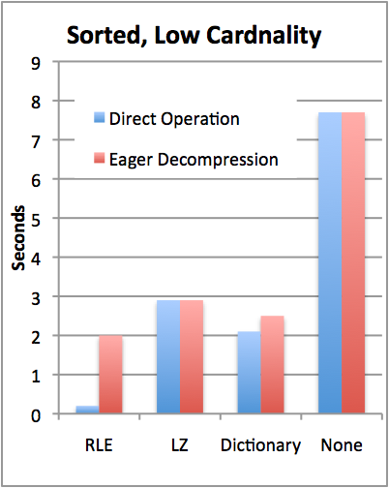
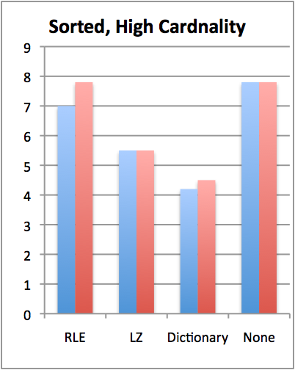

TPC-H Compression Performance
Y | X
1 | A
1 | C
1 | D
2 | B
2 | C
3 | A
Query: SELECT colY, SUM(colX)
FROM lineItem GROUP BY colY
TPC-H Scale 10 (60M records)
Sorted on colY, then colX
colY uncompressed, cardinality varies
Notes:
Consider redesigning

Slide 49
Compression + Sorting is a Huge Win
How can we get more sorted data?
Store duplicate copies of data
Use different physical orderings
Improves ad-hoc query performance
Due to ability to directly operate on sorted, compressed data
Supports fail-over / redundancy
Notes:
We need a new slide that discusses high availability. (Possibly add in a diagram in Vertica tech whitepaper that has a good picture of HA).
Physical schema design duplicates columns on various machines so if one machine goes down you still have a copy.
With traditional systems, you usually have to have two identical systems
No benefit to having two systems
Only use second system on the slim chance that the first goes down.
Wouldn’t it be better if both systems had the same data, but both were optimized for different query workloads?
Vertica makes use of both systems through node clustering
We rope it all into one system,
We provide High Availability and the k-safety you need
k is a measure of the meantime to failure, meantime to recovery
We can do this without dulling computing, because the columns are compressed
We can duplicate columns while still saving space and maintaining k-safe
Redundancy – will get restored by querying the nodes that were running for what happened.
Replication – a DB feature used to replicate a transaction in another DB in order to keep the data in 2 places (use ETL, golden gate etc)
Mirroring (disk) - for redundancy (HW solution). We don’t need that extra cost (all machines do stufff)

Slide 50
Write Performance
Trickle load: Very Fast Inserts
Tuple Mover
Asynchronous Data
Movement
Batched
Amortizes seeks
Amortizes recompression
Enables continuous load
Queries read from both WOS and ROS
Notes:
Writes performance was a surprise

Slide 51
When to Rewrite ROS Objects?
Store multiple ROS objects, instead of just one
Each of which must be scanned to answer a query
Tuple mover writes new objects
Avoids rewriting whole ROS on merge
Periodically merge ROS objects to limit number of distinct objects that must be scanned (like Big Table)
Older objects
Tuple Mover
WOS
ROS

Slide 52
C-Store Performance
How much do these optimizations matter?
Wanted to compare against best you could do with a commercial system

Slide 53
Emulating a Column Store
Two approaches:
Vertical partitioning: for n column table, store n two-column tables, with ith table containing a tuple-id, and attribute i
Sort on tuple-id
Merge joins for query results
Index-only plans
Create a secondary index on each column
Never follow pointers to base table

Slide 54
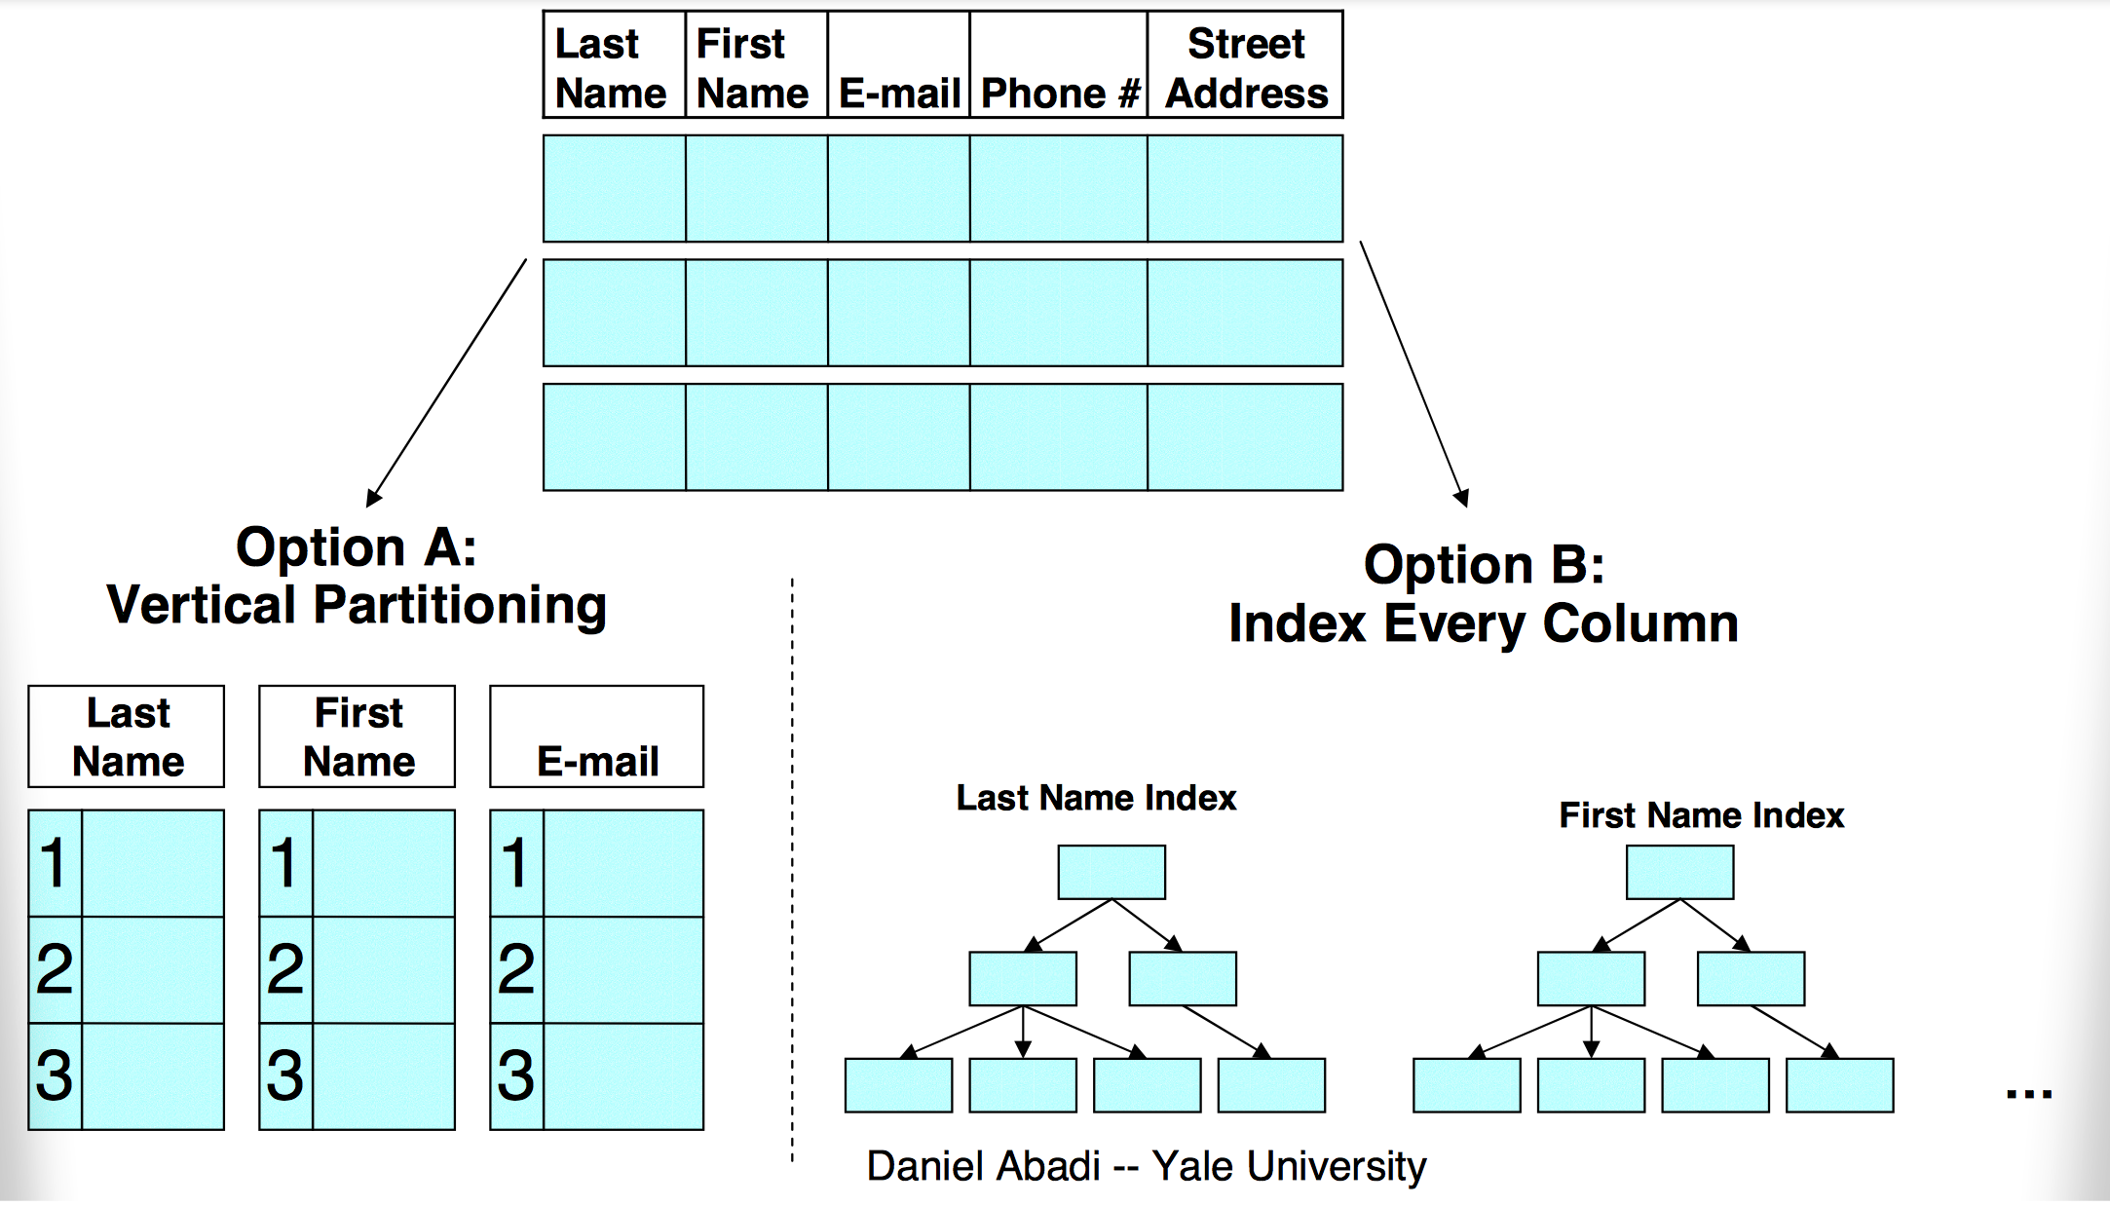
Two Emulation Approaches

Slide 55
Bottom Line
SSBM (Star Schema Benchmark -- O’Neil et al ICDE 08)
Data warehousing benchmark based on TPC-H
Scale 100 (60 M row table), 17 columns
Average across 12 queries
Row store is a commercial DB, tuned by professional DBA vs C-Store
Commercial System Does Not Benefit From Vertical Partitioning
Time (s)
Notes:
Row store partitions on date

Slide 56
Problems with Vertical Partitioning
Tuple headers
Total table is 4GB
Each column table is ~1.0 GB
Factor of 4 overhead from tuple headers and tuple-ids
Merge joins
Answering queries requires joins
Row-store doesn’t know that column-tables are sorted
Sort hurts performance
Would need to fix these, plus add direct operation on compressed data, to approach C-Store performance

Slide 57
Problems with Index-Only Plans
Consider the query:
SELECT store_name, SUM(revenue) FROM Facts, Stores
WHERE fact.store_id = stores.store_id AND stores.country = “Canada”
GROUP BY store_name
Two WHERE clauses result in a list of tuple IDs that pass all predicates
Need to go pick up values from store_name and revenue columns
But indexes map from value→tuple ID!
Column stores can efficiently go from tuple ID→value in each column using position lookups

Slide 58
Recommendations for Row-Store Designers
Might be possible to get C-Store like performance
Need to store tuple headers elsewhere (not require that they be read from disk w/ tuples)
Need to provide efficient merge join implementation that understands sorted columns
Need to support direct operation on compressed data
Requires “late materialization” design

